Slide 1
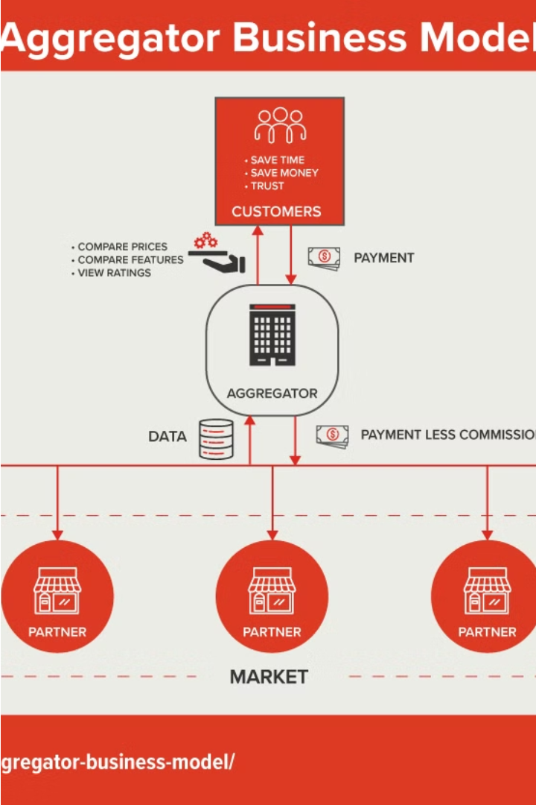
Hotel Aggregator Analysis
Examining the trends and insights in the hotel aggregator industry to inform strategic decision-making.
Ka
by Kuburat Aliyu
Notes:
Welcome!
My name is Aliyu Kuburat.
Today, we'll delve into the fascinating world of hotel aggregators through the lens of data analysis. We'll explore a dataset spanning 2009-2013, a total of 23,185 entries from two sources (city scrape: 16,551, previous scrape: 6,634).
We'll explore geographical trends, pricing patterns, host performance, and more to uncover valuable insights.
For learning purposes:
A city scrape focuses on collecting data specific to a particular city.
while a previous scrape refers to any data collection effort that has already been completed, regardless of location or purpose.

Slide 2


Introduction
Comprehensive Overview
Key Objectives
The presentation will offer a comprehensive overview of the hotel aggregator landscape, empowering stakeholders to make informed decisions.
The key objectives are to uncover geographical insights, identify pricing trends, evaluate host performance, analyze review scores, and explore property type differences.
Purpose of the Analysis
This analysis aims to provide insights into the hotel aggregator market, including geographical trends, pricing patterns, host performance, and property type analysis.
Notes:
The Hotel Aggregator dataset comprises various attributes related to listings, hosts, reviews, and availability. This project aims to create comprehensive visualizations and insights that shed light on trends, patterns, and factors influencing listings' performance. Using a visualization tool, I am expected to explore key metrics such as pricing, availability, host characteristics, and review scores to derive actionable insights for improving the overall quality and competitiveness of the listings.

Slide 3
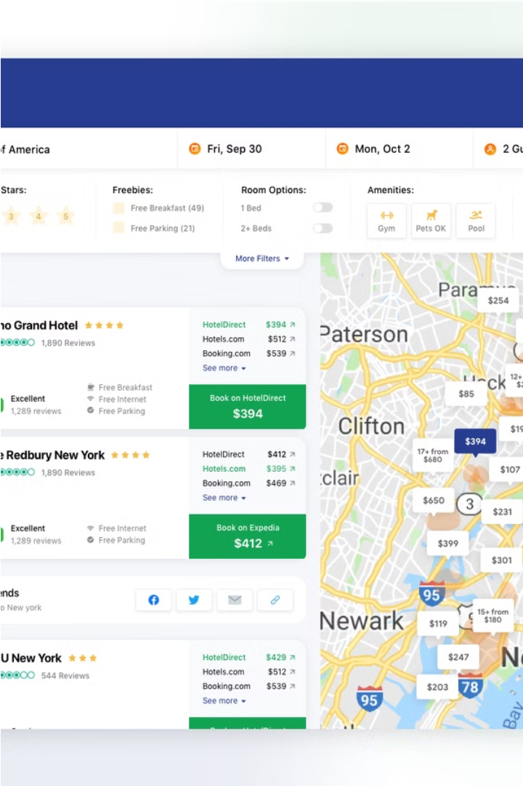
Unlocking Hotel Aggregator Insights:
A Data-Driven Exploration
This analysis will shed light on the geographical distribution of hotel listings, offering valuable insights to optimize business strategies and understand guest preferences.
We'll explore geographical trends, pricing patterns, host performance, and more to uncover valuable insights.
Notes:
2

Slide 4

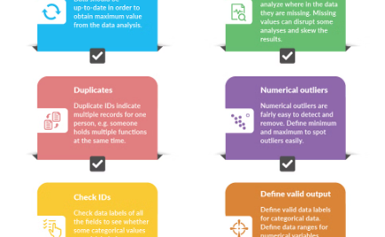
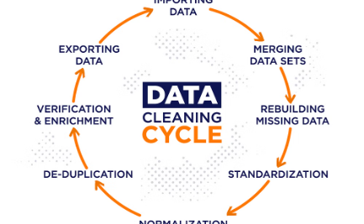
Data Cleaning Summary
Initial Data Structure
Key Cleaning Steps
From Raw to Clean
The initial dataset contained 75 columns and 23,185 rows, spanning a date range from 2009 to 2023.
The data was cleaned by splitting columns, converting boolean values, and removing unnecessary columns to prepare it for analysis.
The cleaning process transformed the raw data into a clean, structured dataset ready for further analysis and insights.
Notes:
Here's a summary of the data-cleaning process:
- I used Power BI for this analysis.
-I Imported the Data
- There were 75 columns and
- 23,185 rows
- Date range for host listing span from 2009-2013 (while data scraping was on September 4th & 5th, 2023)
- No duplicate values were identified.
Cleaning Steps:
- Split host_location into host_city and host_country columns.
- Converted values in boolean columns to True/False.
- Removed irrelevant columns with missing data.
- Output Data:
The final dataset contains 72 cleaned columns and the number of rows remains the same

Slide 5
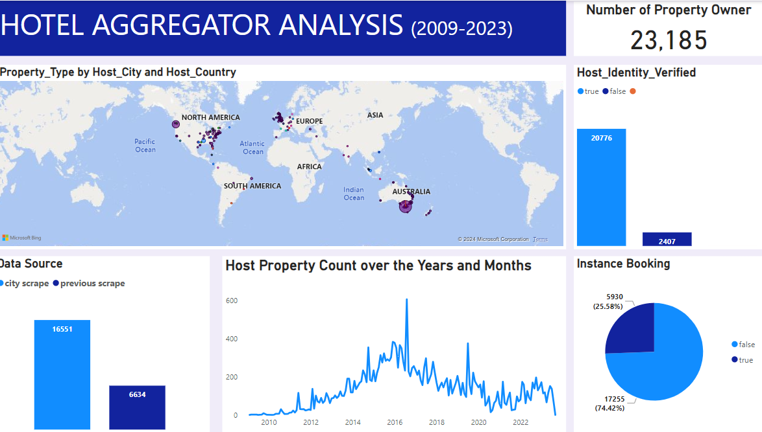
Notes:
A significant portion of listings lack city and country information. The majority of listings allow instant booking. The data shows an upward trend in listings from 2010 to 2013, with seasonal dips in March and September. Australia leads in geographical concentration, followed by the United Kingdom.

Slide 6
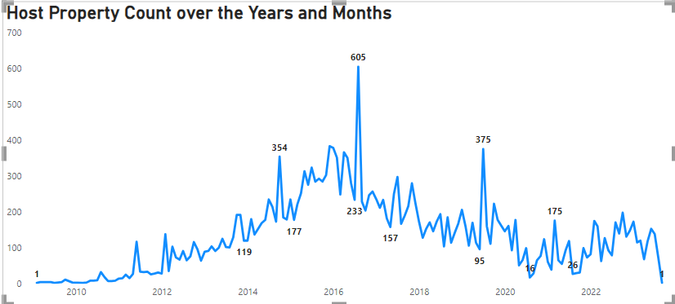
Overview of Hosting
Notes:
A closer look at the Year and Monthly trend.

Slide 7
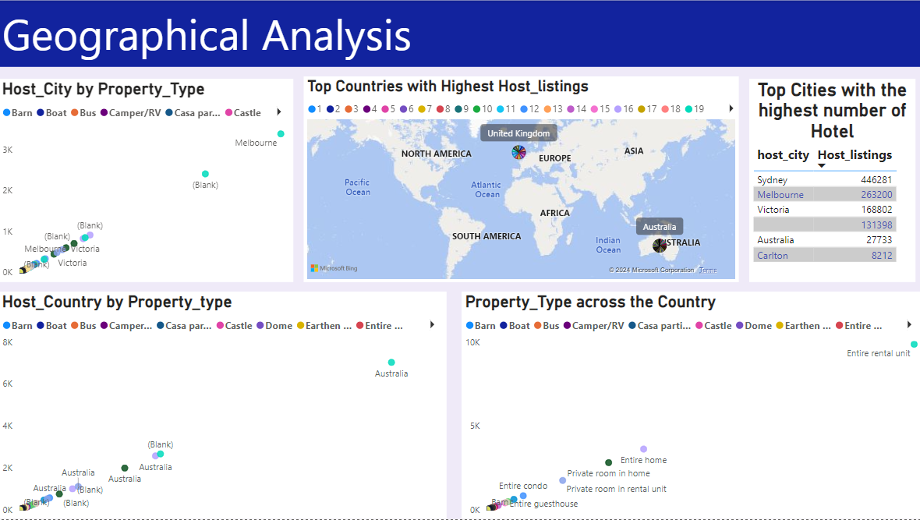
Notes:
Geographical Analysis shows that there are many property listings in Melbourne and its suburbs, such as Carlton, Collingwood, Docklands, Doncaster, Elwood, and Fitzroy, each with over 100 listings. Sidney has the highest number of listings, followed by Melbourne. In total, Australia has 16,199 properties listed, while the United Kingdom is in a distant second place with 106 listings. Although there are listings in various cities, Melbourne and its suburbs have the highest density of listings.

Slide 8
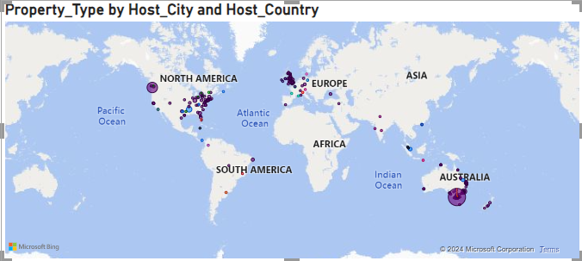
A closer look at the map
Notes:
This slide provides an overview of the geographical distribution of listings across key areas. The focus is on understanding the concentration and spread of accommodations in different regions.

Slide 9
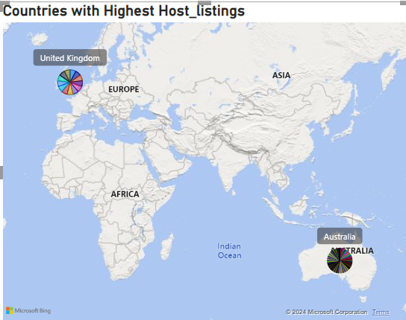
Host_Listings by Country
While 71 countries have hotel listings on the platform, Australia stands out with a dominant presence of 16,199 listings. The United Kingdom comes in a distant second with only 106 listings.
Missing Data
The data set has significant gaps, with 5,899 listings missing city information and 6,476 listings missing country information. This poses challenges for conducting thorough geographical analysis.
Notes:
There are 71 Countries in the listing and Australia stands out

Slide 10
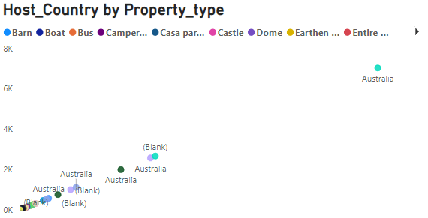
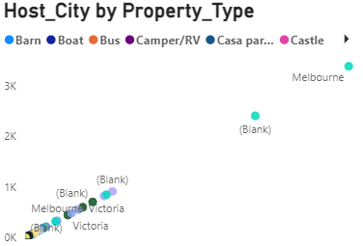
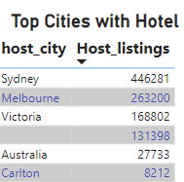
Concentration in Melbourne
Listings by Suburb
The data reveals a significant concentration of listings in Melbourne and its surrounding suburbs. Each of the key suburbs, including Carlton, Collingwood, and Docklands, has over 100 listings, indicating a high density of accommodation options in the city center.
Notes:
8

Slide 11
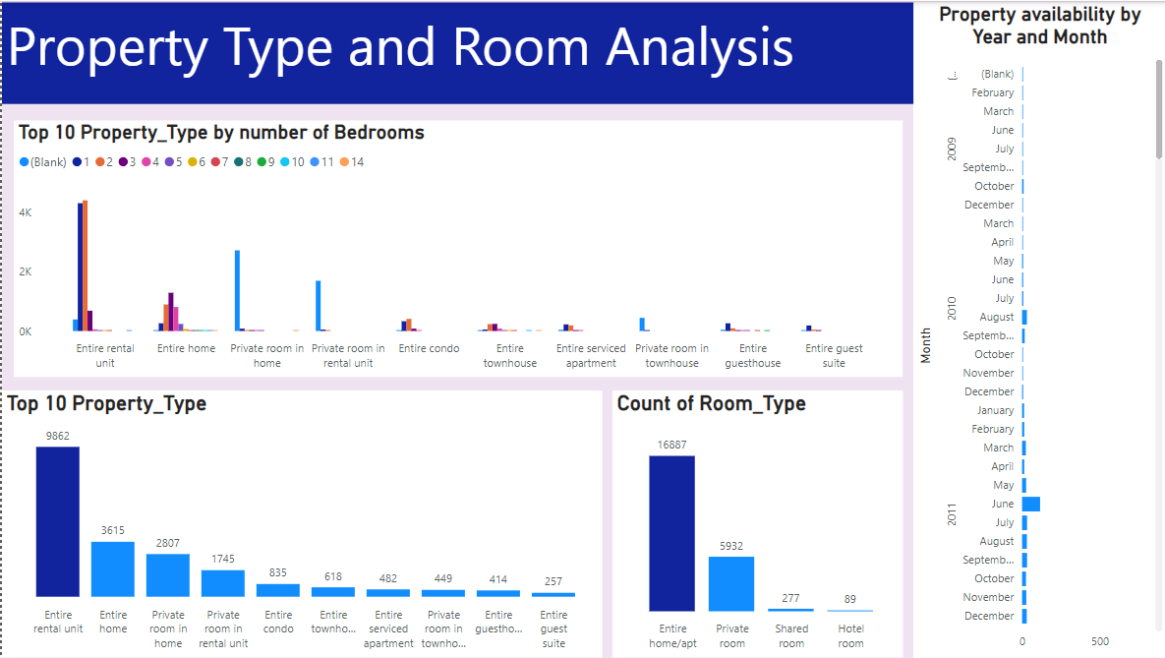
Notes:
• Top 10 property types are Entire rental unit, entire home, private room in home, private room in rental unit, Entire Condo, Entire townhouse, Entire serviced apartment, private room in townhouse, Entire guest house and Entire guest suite.
• Entire homes and apartments dominate the listings with 16,887 while Private rooms come in a distant second with 5,932 listings.

Slide 12
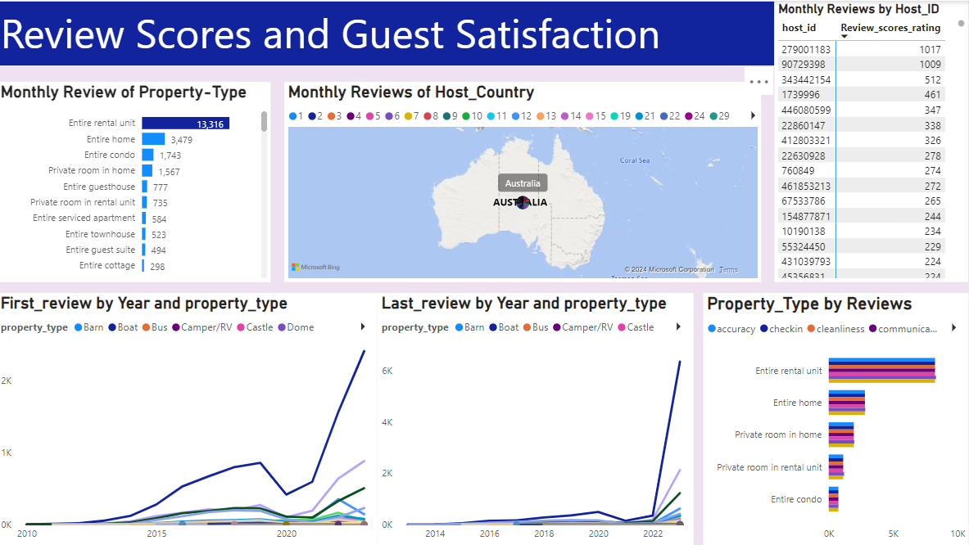
Notes:
• Review Analysis: Entire rental units receive the highest number of reviews, followed by entire homes and private rooms. The reviews cover various aspects such as accuracy, check-in, cleanliness, communication, location, and value. Review scores show a positive trend initially, with a dip between 2020 and 2022, followed by an upward trend until 2023.
• Guest Satisfaction: The analysis of review categories indicates that guests generally favor entire rental units. However, there are areas for improvement in cleanliness and check-in processes.
• Review Trends: While initially positive across all property types (entire rental unit having the highest), there was a dip from 2020-2022, followed by an upward trend until 2023.

Slide 13
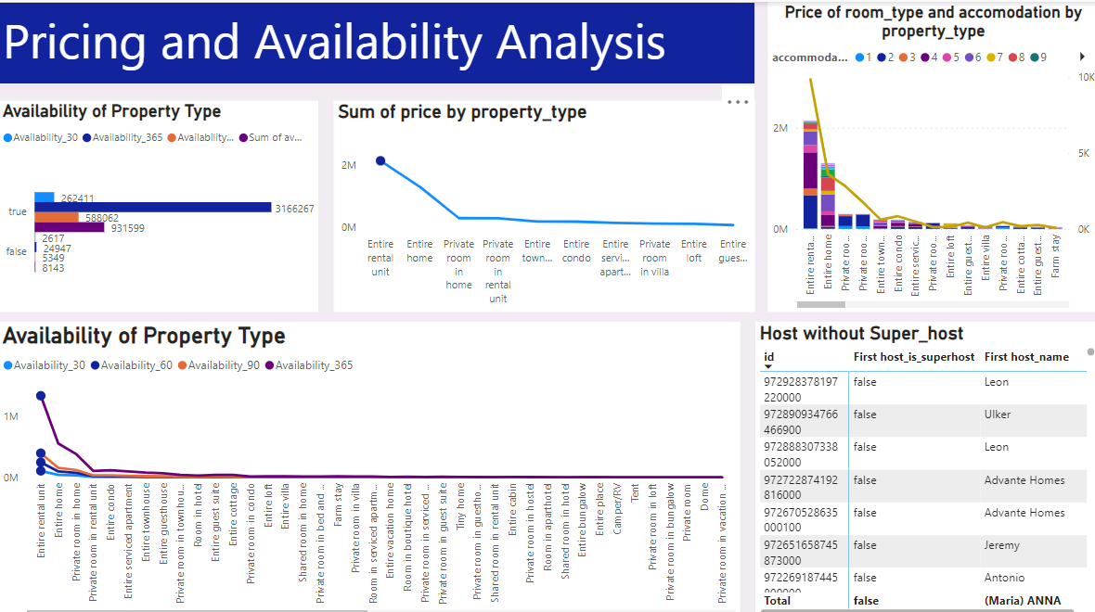
Notes:
• Property Availability Distribution: The majority of properties are entire homes/apartments (16,887), followed by private rooms (5,932), shared rooms (277), and hotel rooms (89).
• Accommodation Trends: Entire rental units and entire homes are the most popular property types, showing higher demand and reviews compared to other types.
• Pricing Trends: Entire rental unit have the highest total pricing, contributing over 2 million, Entire home with 1,302,400, And others below 500,000. Private rooms and shared rooms have significantly lower total pricing.
• Availability Trends: Listings show consistent availability throughout the year, with 365 days being the most common availability. The trend indicates an increase in property availability starting from October 2014, with August 2016 being the peak period for hosting. Seasonal dips are observed in March and September annually.

Slide 14
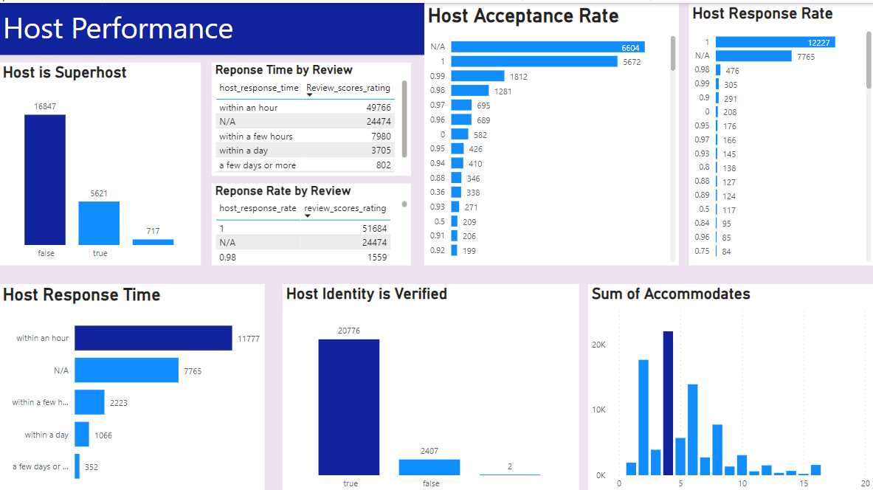
Notes:
Host Performance and Characteristics:
• Superhost Status: The data reveals 5,621 Superhosts, 16,847 non-Superhosts, and 717 with missing status. Hosts responding within an hour tend to receive higher ratings, highlighting the importance of quick response times.
I discover this through research and not from the project information.
To qualify for Superhost status, hosts must meet specific criteria, including:
o Hosting a certain number of nights or reservations per year.
o Maintaining a high overall guest rating (typically above 4.8 stars).
o Having a low cancellation rate.
o Responding promptly to guest inquiries.
• Response Times: Over 11,000 hosts respond within an hour, with more ratings compared to those with slower response times.
• Verification and Booking: Of the total hosts, 20,776 are verified, and 2,407 are unverified. Instant booking is available for 17,255 properties, whereas 5,930 properties do not offer this feature.

Slide 15
Limitation
Incomplete Data
Lack of Customer Data
Temporal Gaps
Notes:
Incomplete Data: There are significant gaps in the data, with 5,899 properties missing city information and 6,476 properties lacking country information. This limits the accuracy of geographical analysis.
Lack of Customer Data: The dataset does not include information about customer locations or their travel preferences, which restricts the ability to analyze customer behaviour and preferences.
Temporal Gaps: The dataset spans from 2009 to 2013, with a notable dip in data quality and quantity from 2020 to 2022, potentially affecting the analysis of trends during these years.

Slide 16
Recommendations
Data Completion
Investigate August Peak
Seasonal Trends
Enhanced Customer Insights:
Notes:
Recommendation
1. Complete missing city and country data for accurate geographical analysis.
2. Investigate the August 2016 listing surge for contributing factors and future leverage.
3. Examine March and September dips for seasonal travel patterns and market dynamics.
4. Collect customer location and preference data for improved customer behaviour analysis and marketing strategies.

Slide 17
What Next?
Data Exploration:
Investigate the cause of the significant listing surge in August 2016. Analyze factors like holidays, events, pricing changes, or marketing campaigns that might have contributed to the increase. Understanding the reasons could help leverage similar strategies in the future to boost listings during slow periods.
Data Analysis:
Examine the recurring dips in listings observed in March and September. Analyze travel trends and market dynamics to understand if these dips are seasonal. This analysis can help predict future trends and develop strategies to incentivize listings during these periods.
Data Collection Strategy:
Implement methods to collect customer location and preference data. This could involve surveys, user profiles, or integrating with travel booking platforms. Analyzing customer behaviour based on location and preferences allows for targeted marketing strategies and improved customer experience.
Notes:
The next steps involve acquiring missing data, exploring the reasons behind listing surges, analyzing seasonal trends, and collecting customer data for more informed decision-making.
Focus on collecting missing city and country data for a more accurate geographical analysis of listings. This could involve contacting hosts, scraping additional information from websites, or implementing user input fields during listing creation.
= Data Exploration:
= Data Analysis:
= Data Collection Strategy:

Slide 18
Thank You
Notes:
Thank You

